Slide 1


Addressing the Insufficiencies in CARLA Simulator
Electrical & Computer Engineering
Advisor: Professor Ravishankar Iyer
Ziheng Chen
05/03/2023
Notes:
Hi, welcome to my presentation on addressing the insufficiencies in Carla simulator, a widely used Simulation tool for Autonomous vehicles

Slide 2

Outline
Background
Importance Of Simulators
Current Problems
Motivating Example
Implementation
Friction Model
Test Parameters
Evaluation
Selected Results
Conclusion
Future Work
ELECTRICAL & COMPUTER ENGINEERING
GRAINGER ENGINEERING
Notes:
In this presentation, I will start with an introduction to the background. I will discuss why we use simulation in autonomous vehicles, some current problems, and provide an example to convey my motivation.
Then I will briefly talk about the model I chose to implement in my project, and how I collected the data.
Then I will discuss a few representative results.
At last, I will draw a conclusion and show my future works.

Slide 3
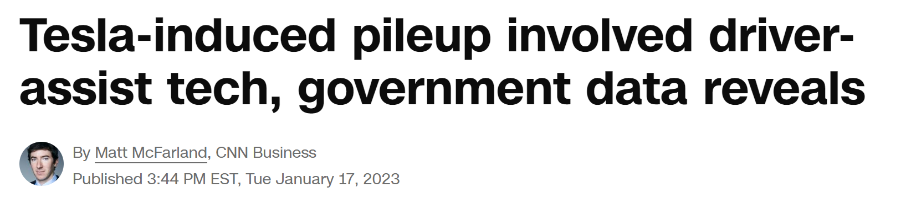
Background
Why Use Simulators
The safety of AVs has always been at the center of the discussion. [1]
From July 2021 to May 2022, the NHTSA collected 273 crashes involving Tesla’s Autopilot or the Full Self Driving mode, which includes five fatal crashes. [2]
Training a robust system requires a large dataset.
Generating computer-simulated datasets has been advantageous in speed, cost, and safety.
ELECTRICAL & COMPUTER ENGINEERING
GRAINGER ENGINEERING
Notes:
Before diving into simulation, we need to know why we use simulators.
The safety of AVs has always been at the center of the discussion. However, despite an enormous amount of training time, accident from all over the country pointed out the INSUFFICIENCIES of autonomous vehicles in practice.
As an example, the headline here highlights an accident caused by Tesla’s “full self-driving” software. The system braked unexpectedly while cutting to the left most lane.
Also, from July 2021 to May 2022, the the National Highway Traffic Safety Administration collected 273 crashes involving Tesla’s Autopilot or the Full Self Driving mode, which includes five fatal crashes [1].
As you might know, training a robust system requires a large dataset.
To consistently perform well in different adverse situations, the AV first need to learn to behave in a wide variety of scenarios therefore heavily rely on datasets containing adverse scenarios.
Generating diverse datasets using computer simulation has been advantageous for its speed, cost, and safety,
and as a result, computer simulation is commonly used in the industry to support the development and benchmarking of AV systems.

Slide 4
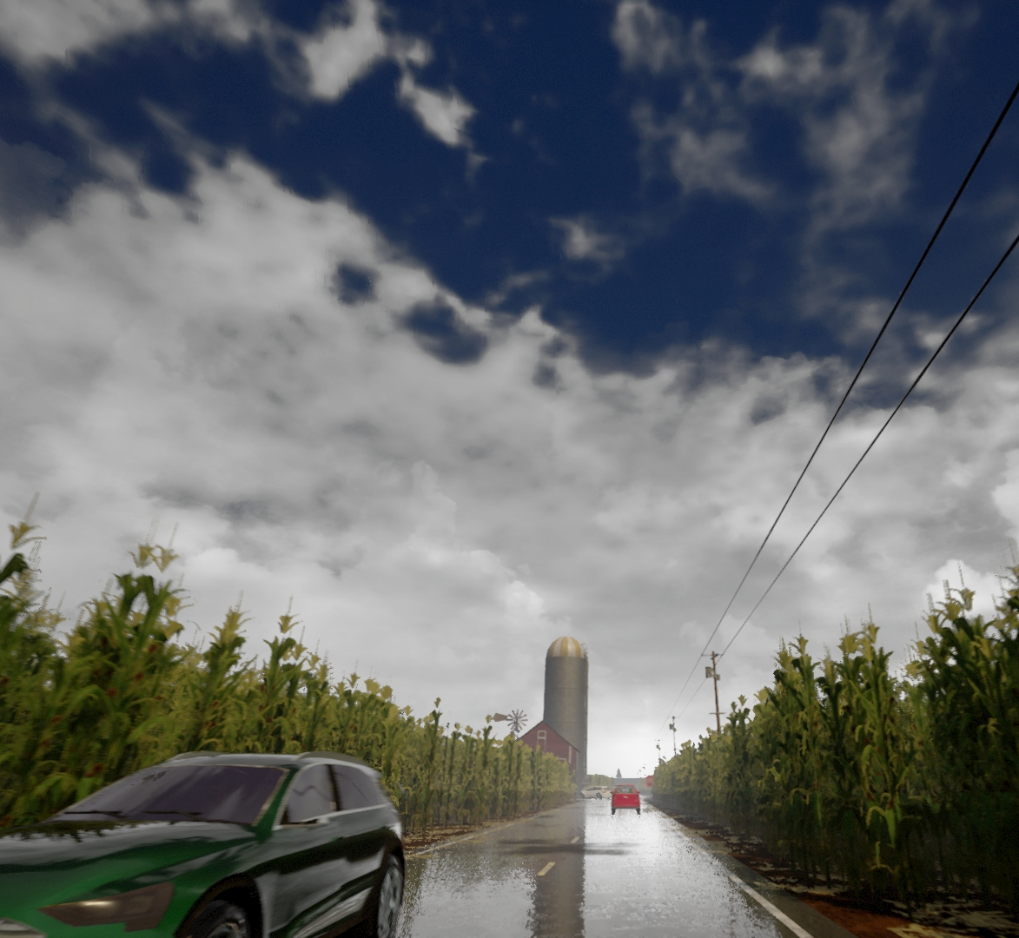
Background
Current Issues
Resemblance to the real world
Underrepresents the challenges
CARLA Simulator can produce visual effects in various weathers
Do not affect physics such as friction [3]
Output deviates from real behavior
Purpose of Research
Improving the realism of CARLA
Introduce friction according to model
Compare effect of modification
ELECTRICAL & COMPUTER ENGINEERING
GRAINGER ENGINEERING
Notes:
However, simulators also possess innate disadvantages, with the most critical factor being the level of resemblance to the real world.
The CARLA simulator often underrepresents the challenges of driving in real life, especially under complex physics, limited lighting, and emergency scenarios.
For example, the CARLA simulator, among the most widely used simulators, can reproduce realistic and convincing visual effects under various weather. The render in the background is from the official website. You can clearly see the detailed plants on the side and the reflection on the wet road.
However, the amount of rain only affects the perception of AVs without affecting the friction of vehicles, which leads to an astonishing disconnection between the simulation and the real world. As a result, the simulator’s output deviates from the expected behavior in the real world.
The purpose of my thesis is to improve the realism of the CARLA simulator. I address the above issues by introducing friction to vehicles in rainy and icy scenarios.
This thesis will compare the effectiveness of the proposed improvement by comparing the behaviors of the vehicle before and after modifications and other metrics.

Slide 5
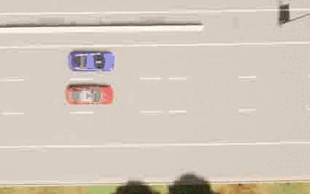
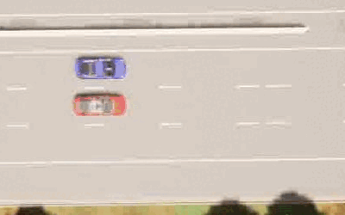
Background
Motivating Example
A common cut-In scenario
With Original Friction
With Reduced Friction
NPC (blue) cuts in front of the ego-vehicle (red) controlled by pre-trained visual-based model.
ELECTRICAL & COMPUTER ENGINEERING
GRAINGER ENGINEERING
Notes:
Here is a motivating example. It shows a scenario that frequently happens in the real world. In blue, an NPC vehicle, cuts in front of the ego vehicle in red. The ego vehicle is running a pre-trained network using 3 front-ward facing cameras as input. There is a layer of ice on the road in both cases, but on the left, the friction isn’t reduced natively, the ego vehicle brakes and stops to avoid a collision.
On the right, after modification, friction is reduced, and the NPC vehicle spins out of control when cutting in.
This motivating example shows that the modified friction can render a completely different outcome from a designed scenario, and it successfully demonstrated that the modification proposed in this thesis is capable of generating a more realistic behavior under the icy weather.

Slide 6
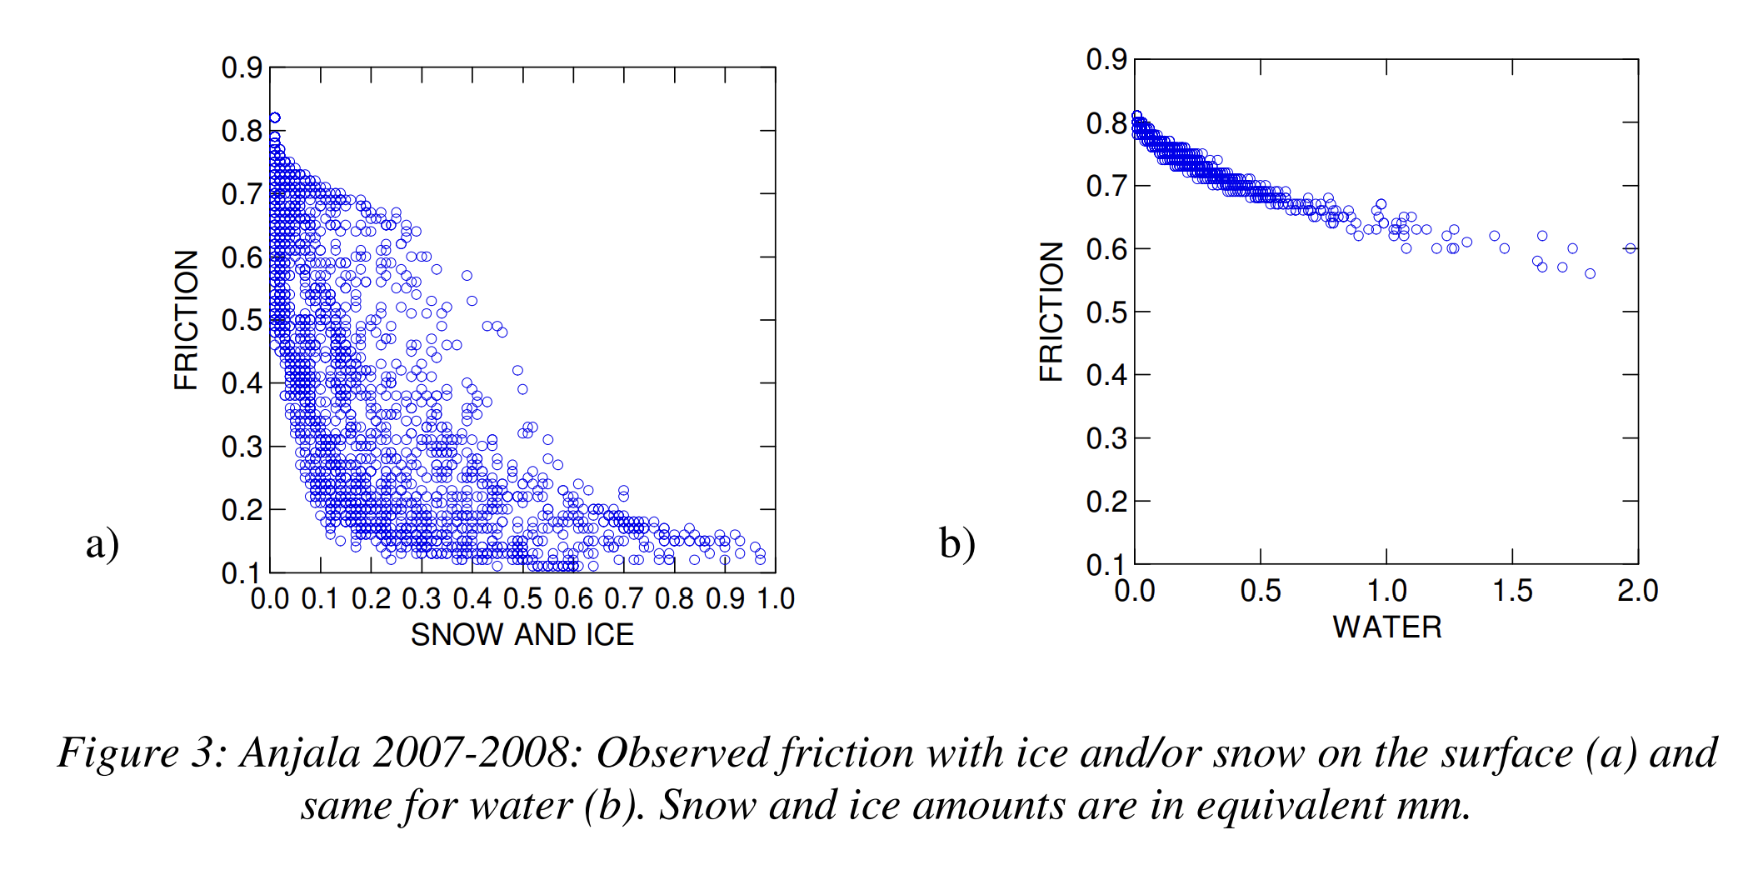
Implementation
Friction Model from Literature
Accurate, lightweight, and easy interpretation.
[4] Hippi, Marjo & Juga, Ilkka & Nurmi, Pertti. (2010). A statistical forecast model for road surface friction.
ELECTRICAL & COMPUTER ENGINEERING
GRAINGER ENGINEERING
Notes:
In order to make the correct reduction of friction, the model must be accurate, lightweight for fast computing, and has to be interpretable.
I turned to a statistical model from the Finnish Meteorological Institute. It is used to forecast friction on the road with parameters such as thickness of snow, ice and water, all measured in mm.
Note that the y axis does not represent the coefficient of friction but a friction ratio from 0 to 1.

Slide 7
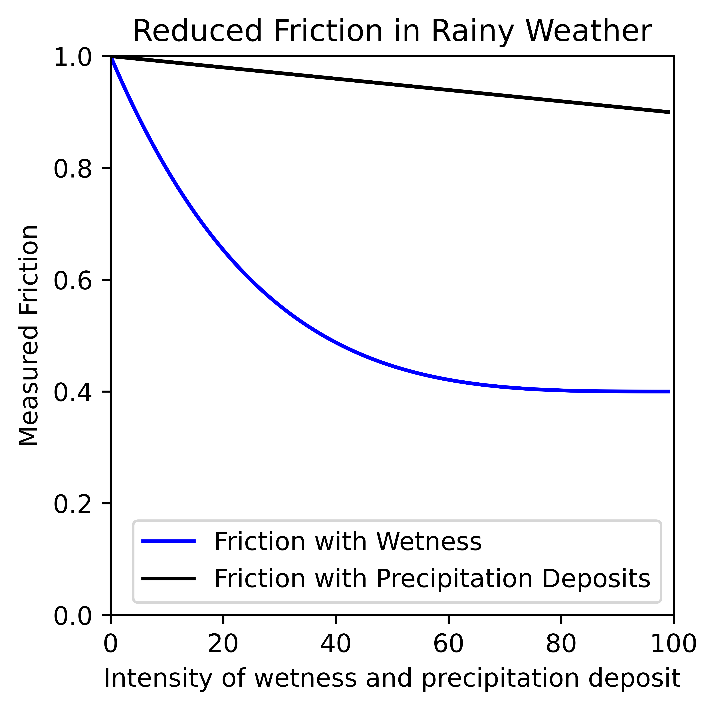
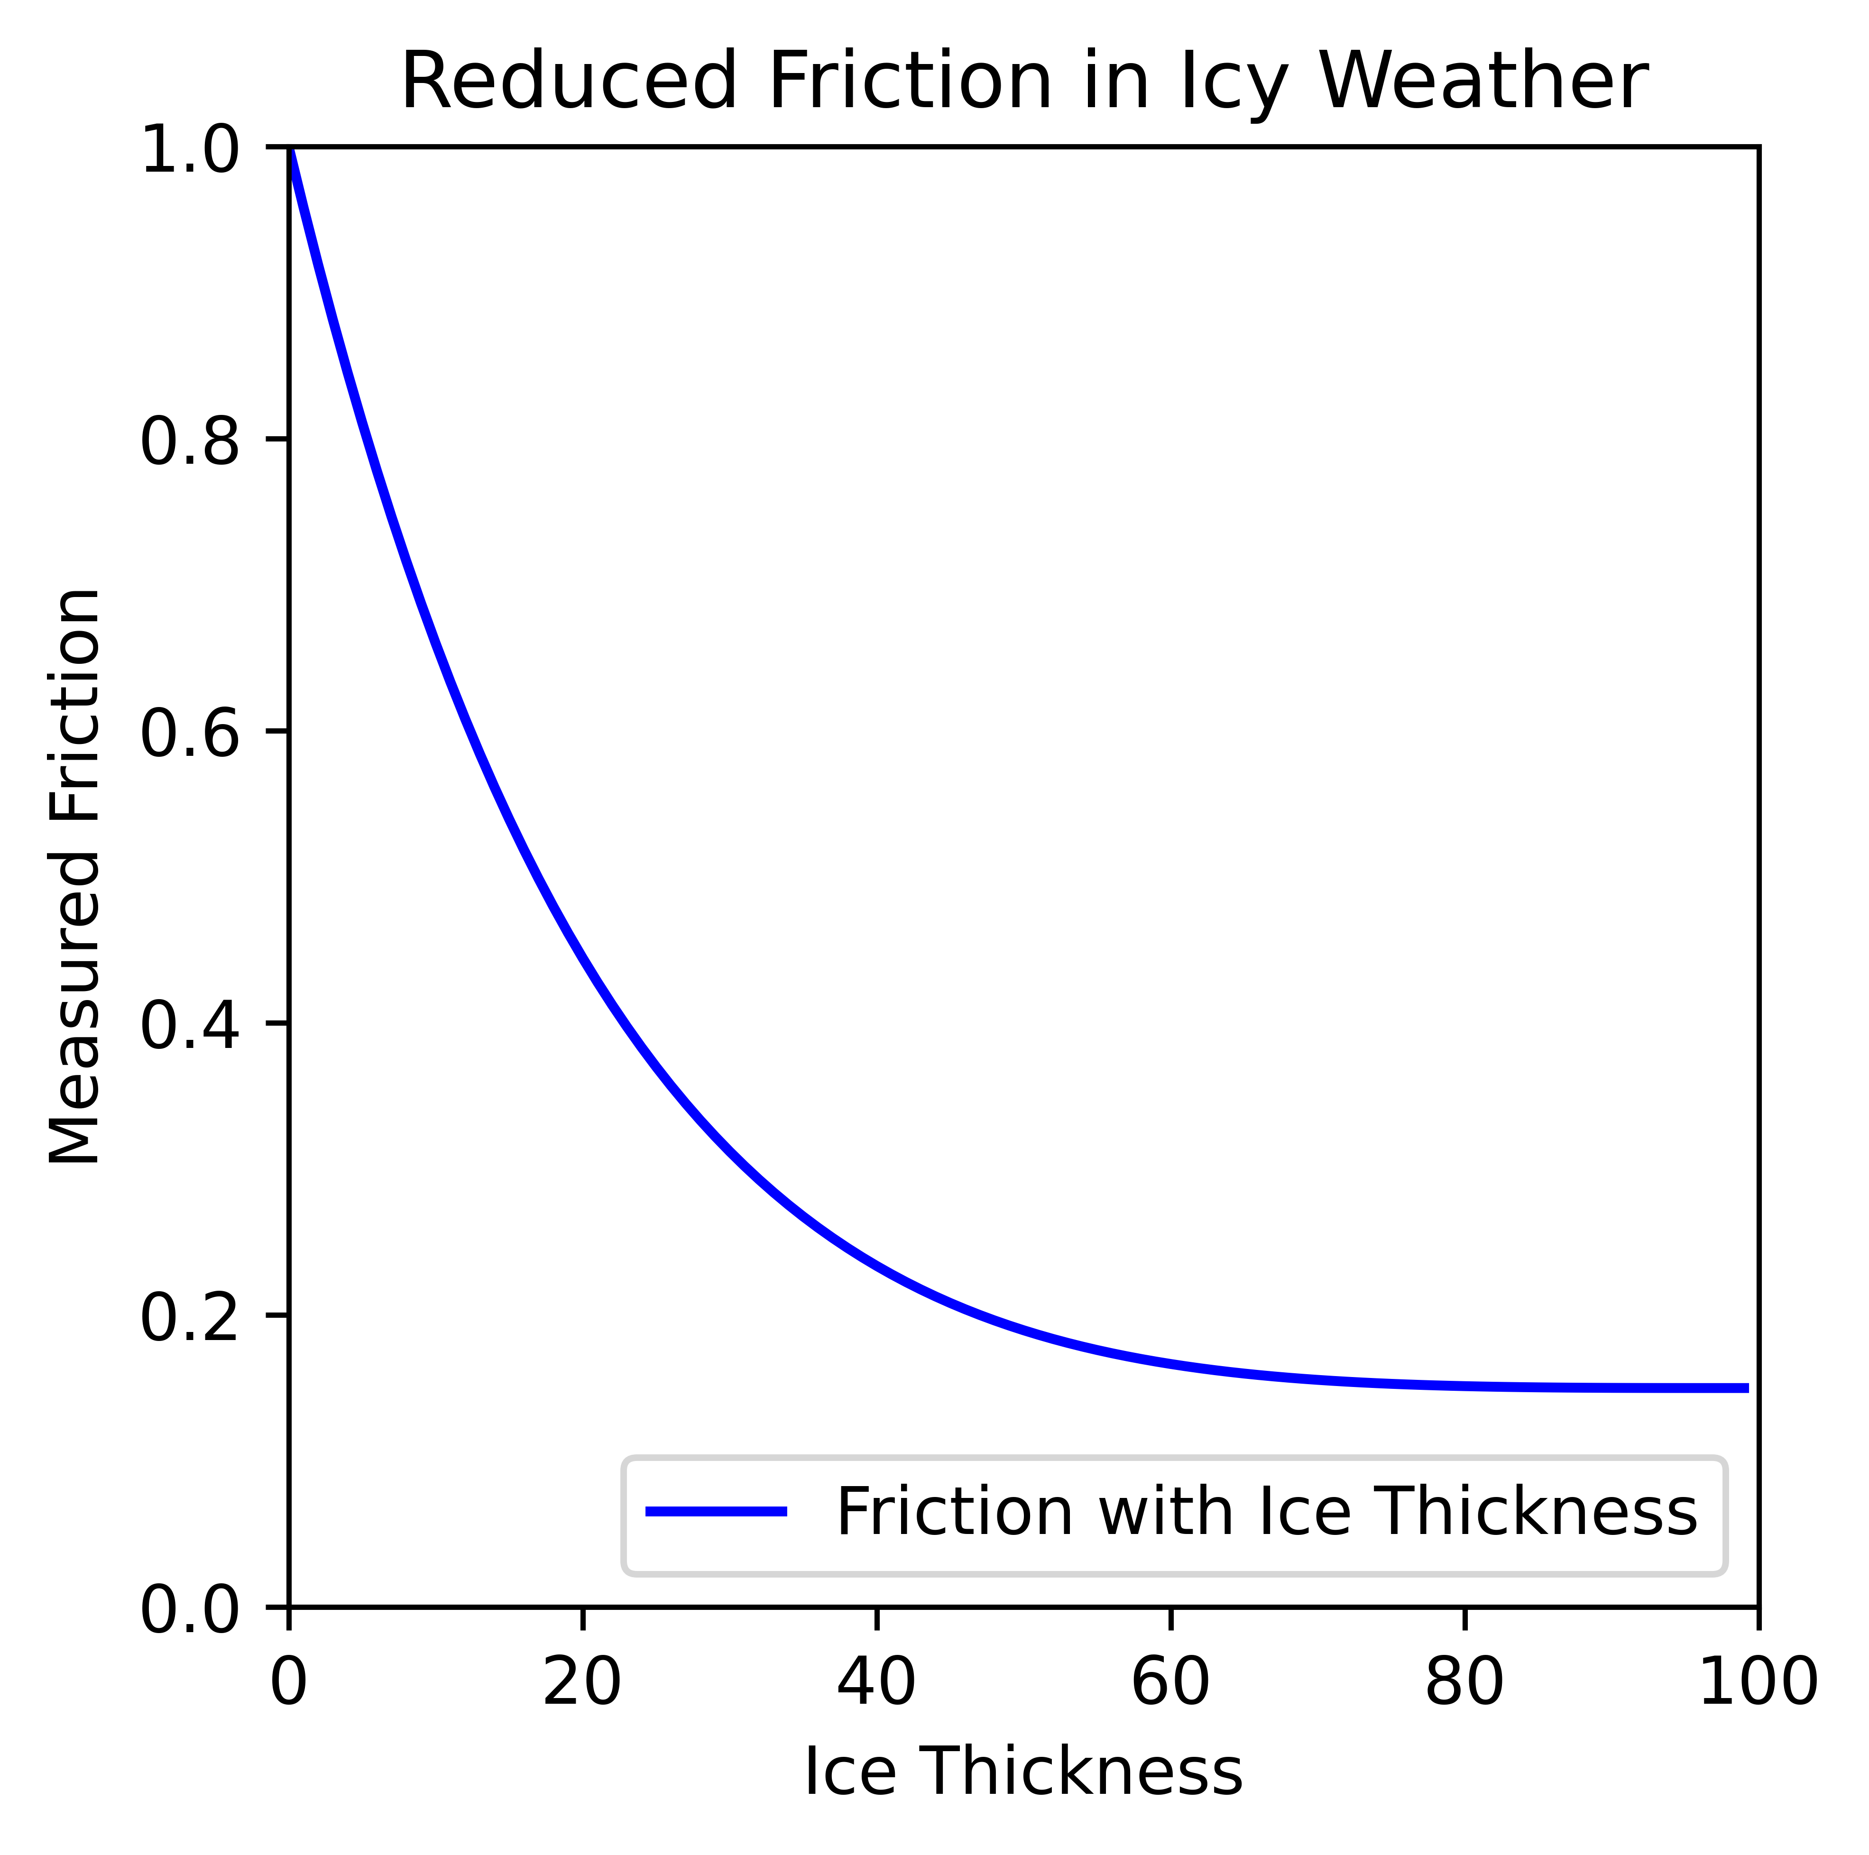
Implementation
Friction Model Implemented
Model based on data from the statistical method.
ELECTRICAL & COMPUTER ENGINEERING
GRAINGER ENGINEERING
Notes:
Here is the curve of friction that I created based on the previous paper. It follows the general exponential decaying trend of the previous plots.
The only difference is that in this model, I assume that the amount of precipitation deposits, or water puddles, colored in black in the left plot, also reduces the friction ratio by a small amount in addition to the wetness of the road, colored in blue in the left plot.
The friction ratio can be calculated using the above model given a weather parameter, and the new reduced friction is obtained by multiplying the friction ratio with the original friction in the simulation pipeline.

Slide 8
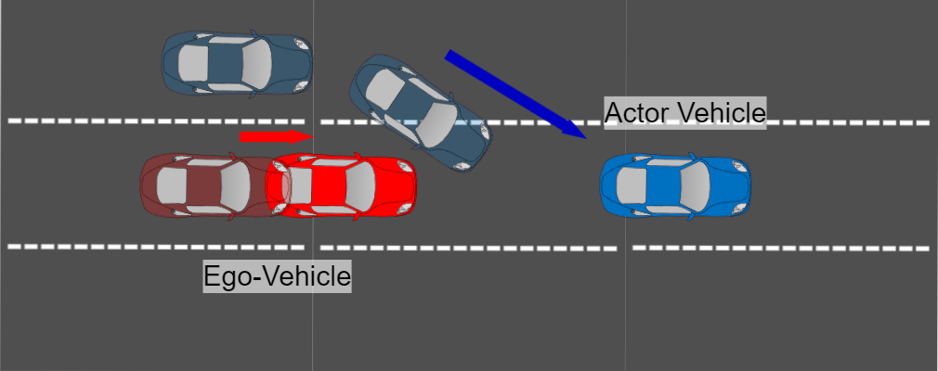
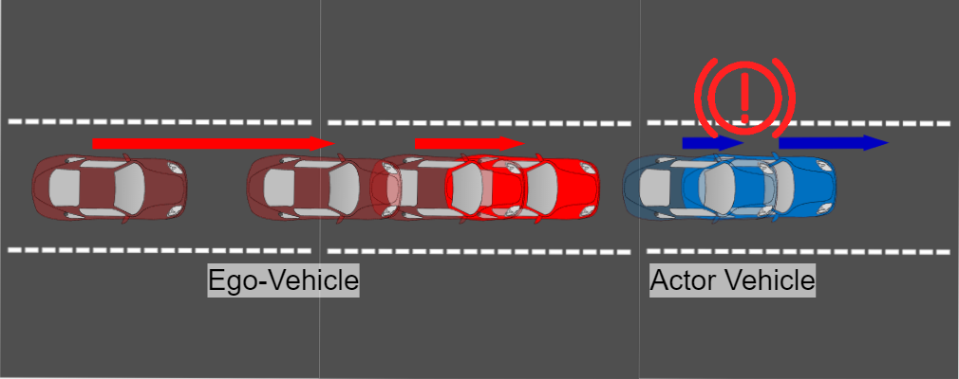
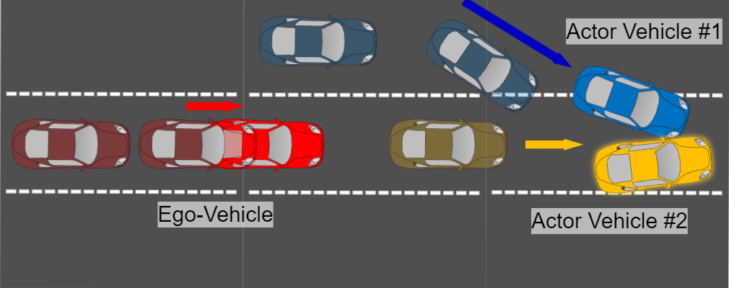
Implementation
Test Parameters: Scenarios
Ghost Cut-in Scenario
Lead Slowdown Scenario
Front Accident Scenario
ELECTRICAL & COMPUTER ENGINEERING
GRAINGER ENGINEERING
Notes:
Now moving on to test parameters. Here are the three scenarios are used for benchmarking.
The top left is the cut-in scenario, shown in the motivating example, where the AV needs to react to a cutting NPC vehicle by braking.
To the right is the lead slowdown scenario, where the AV needs to react to a braking NPC vehicle.
Last, the bottom shows the front accident scenario, where the AV needs to react to an accident ahead.

Slide 9
Implementation
Test Parameters: Weather Parameters
Weather Parameter Name | Cloudiness | Precipitation | Precipitation Deposits | Wetness | Fog Density | Wind Intensity | Ice Thickness | Measured Friction
rain_0 | 20 | 0 | 0 | 0 | 0 | 10 | 0 | 1
rain_20 | 20 | 20 | 20 | 20 | 5 | 20 | 0 | 0.63
rain_40 | 40 | 40 | 40 | 40 | 10 | 30 | 0 | 0.45
rain_60 | 60 | 60 | 60 | 60 | 15 | 40 | 0 | 0.36
rain_80 | 80 | 80 | 80 | 80 | 20 | 50 | 0 | 0.32
rain_100 | 100 | 100 | 100 | 100 | 30 | 70 | 0 | 0.3
icy_0 | 20 | 0 | 0 | 0 | 0 | 10 | 0 | 1
icy_10 | 20 | 0 | 0 | 10 | 0 | 10 | 10 | 0.66
icy_30 | 20 | 0 | 0 | 30 | 0 | 10 | 30 | 0.31
icy_70 | 20 | 0 | 0 | 70 | 0 | 10 | 70 | 0.16
icy_100 | 20 | 0 | 0 | 100 | 0 | 10 | 100 | 0.15
ELECTRICAL & COMPUTER ENGINEERING
GRAINGER ENGINEERING
Notes:
To measure the effectiveness of modifying the friction, I created several weather configurations with various degree of rain intensity and ice thickness.
On the top half are the rainy scenarios. , and on the bottom half are the icy scenarios. Each increases in intensity from top to bottom.
The right most column is the measured friction ratio. The friction decreases more drastically at first. In icy scenarios, it eaches a much lower amount compared to rain scenarios.

Slide 10
Implementation
Test Parameters: Metrics
Metric | Description | Data Type
cvip | The distance from the ego vehicle to the NPC vehicle | float
Completion Ratio | The percentage of trials not resulting in an accident. The status of the simulation is completed. | float
Average Score | The average of safety violations (infractions). An infraction results in a score of less than 100.0. | float
Evaluation
For each scenario:
with each weather parameter
with and without friction
Repeat 100 times, record metrics
Calculate median of the metrics.
ELECTRICAL & COMPUTER ENGINEERING
GRAINGER ENGINEERING
Notes:
All telemetry and control values are recorded, but here are some of the important metrics collected.
Cvip is the distance between the ego vehicle and the NPC vehicle.
The completion ratio shows the percentage of completed trials, which means no accident happened.
The average score shows the average of safety violations. For example, score decreases when the vehicle goes out of a lane unexpectedly.
Moving on to the evaluation. For each scenario, it will be paired with all weather parameters. Each pair is run separately with and without friction, both repeated 100 times, and the median of the metrics will be studied to prevent outliers.

Slide 11
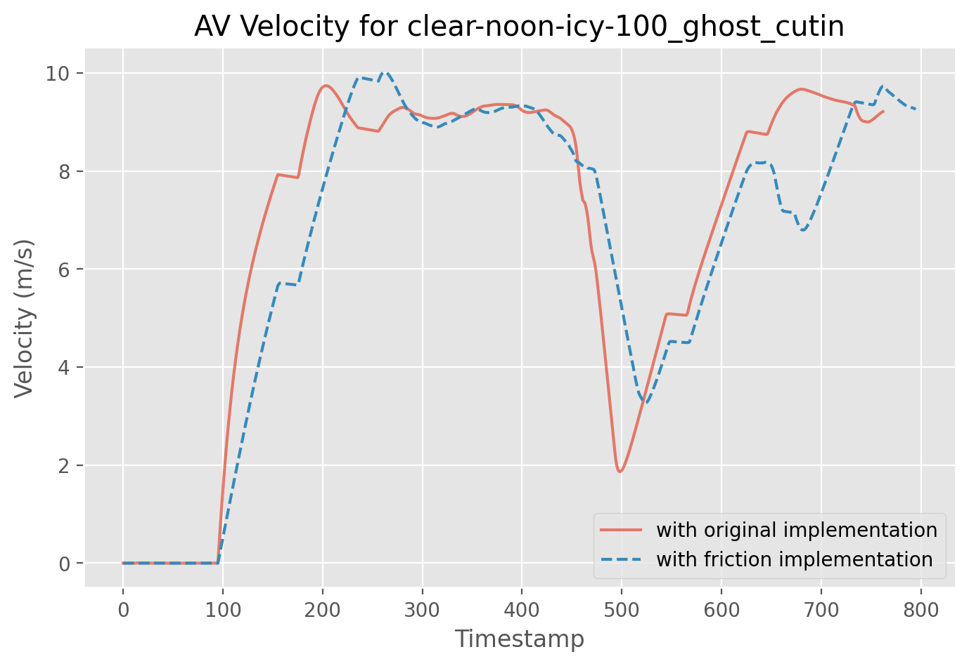
Results
Cut-in scenario when ice is thickness suggests a delay in motion.
ELECTRICAL & COMPUTER ENGINEERING
GRAINGER ENGINEERING
Notes:
Here I will explain the generated results using some distinguish examples from the outcomes.
Two trends can be observed when I compare the outcomes from same weather condition in the same scenario, with the only difference being the friction.
The plot describes a cut-in scenario when the ice is the thickest. The orange line represents the velocity of ego-vehicle with original friction, and blue is reduced friction. In both cases, the ego vehicle gets up to speed by timestamp 300 before braking for the cutting in vehicle around timestamp 500. After the road is cleared, the ego-vehicle accelerates again.
You can see the velocity of the ego vehicle sharing a similar shape with distinct peak, in the top left box, and trough, on the bottom right box. However, with reduced friction, the trace gets delayed for a constant duration, as shown in the arrow around timestamp 100.
That is because the vehicles take longer to accelerate and reach the state of action.

Slide 12
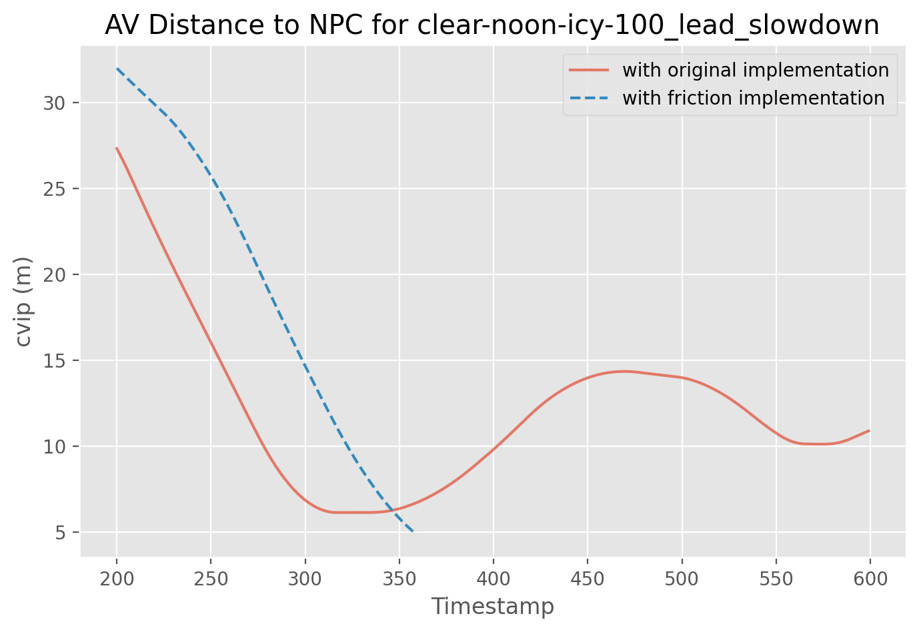
Results
Lead slowdown scenario when ice is thickness causes collision.
ELECTRICAL & COMPUTER ENGINEERING
GRAINGER ENGINEERING
Notes:
Besides the delay, another trend is that the modified friction will render an unexpected and different outcome from a designed scenario.
Again, we are comparing the outcomes from same weather condition in the same scenario, in this case when the ice is both thickest in a lead slowdown scenario. The orange line shows the distance between the ego vehicle and npc.
Starting at timestamp 200, the ego-vehicle at a higher velocity brakes for the slow lead vehicle, which causes the cvip to decrease dramatically. With original friction, the ego-vehicle stops in time and continue to finish the simulation. However, with reduced friction, we can see a similar delay in time during braking, but instead of following the cvip in the original implementation, the ego-vehicle did not stop in time and crashed into the lead vehicle. Shown in the red box, the blue line stopped after the collision since the simulation is terminated.
Here, reducing friction can result in a collision. The ego vehicle could not brake as efficiently and eventually collided with the NPC vehicle.

Slide 13
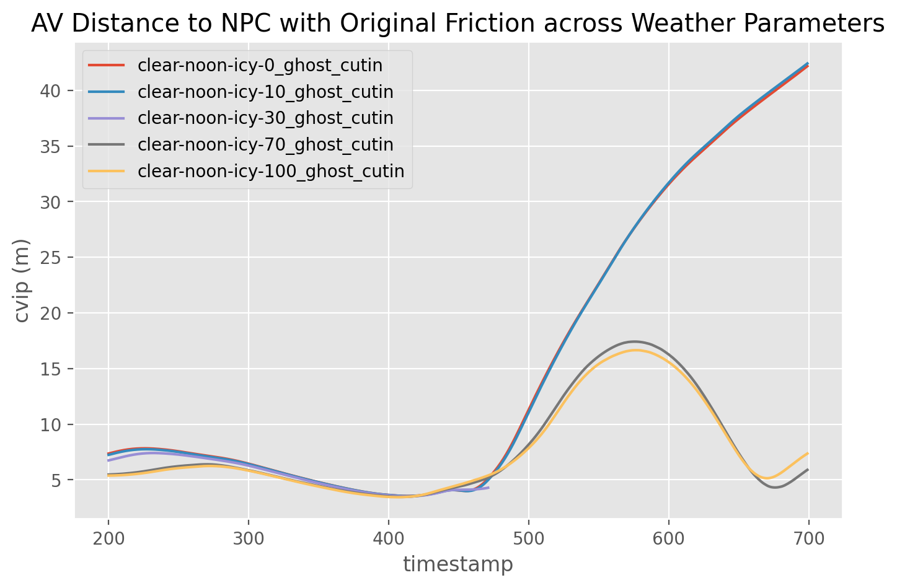
Results
In cut-in scenario, reducing friction too much can cause different behavior.
ELECTRICAL & COMPUTER ENGINEERING
GRAINGER ENGINEERING
Notes:
Here, I looked at the whole picture and compare the effect of weather parameters. The scenario is fixed, in this case the cut-in scenario, and the friction is reduced according the varying icy weather parameters.
I compared the distance between the ego vehicle and the NPC vehicle as the ice thickness increases in the cut-in scenario.
Normally with almost unchanged friction, after timestamp 400, the ego vehicle can re-accelerate after braking and catch up to the NPC vehicle ahead, which is why the distance between the two vehicles start to increase as fast towards the end. However, show in the red box, It is also common for the npc vehicle to completely lose control, as shown in the motivating example. In this case, there is no NPC vehicle to catch up, and the distance between the vehicles does not increase since the ego-vehicle does not brake and get passed by the NPC.

Slide 14
Results
DTW Comparison across Icy Weather Parameters for All Metrics
DTW Comparison across Rainy Weather Parameters for All Metrics
ELECTRICAL & COMPUTER ENGINEERING
GRAINGER ENGINEERING
Notes:
Since the trajectories are time series, dynamic time warping , or DTW, is used to study further the difference made by friction reduction. DTW is an algorithm for measuring the similarity between two temporal sequences
The top table shows the DTW of trajectories with and without reduced friction in icy weather in cut-in scenario. since the scenarios remain unchanged when no ice is present, the first row, clear-noon scenario could be used as a baseline for comparison. Any DTW values similar to the first row indicate minimal change. It can be easily observed that all other scenarios received higher DTW than the baseline scenario, in both trajectory metrics, and control metrics, indicating that having reduced friction significantly changed the output. When ice thickness is at 30%, the DTW values significantly changed, in this case, it showed that it caused a collision to happen.
The bottom table shows the DTW of trajectories with and without reduced friction in rainy weather in cut-in scenario. Similar trends can be observed, where all scenarios produced higher DTW values in all metrics as a result of reducing friction, despite not having an accident.

Slide 15
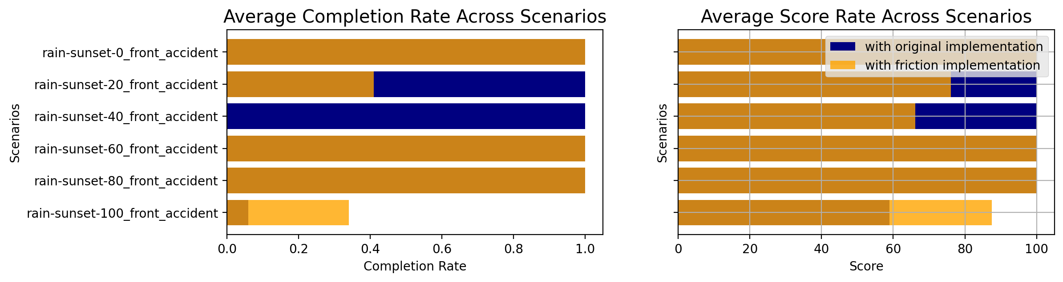
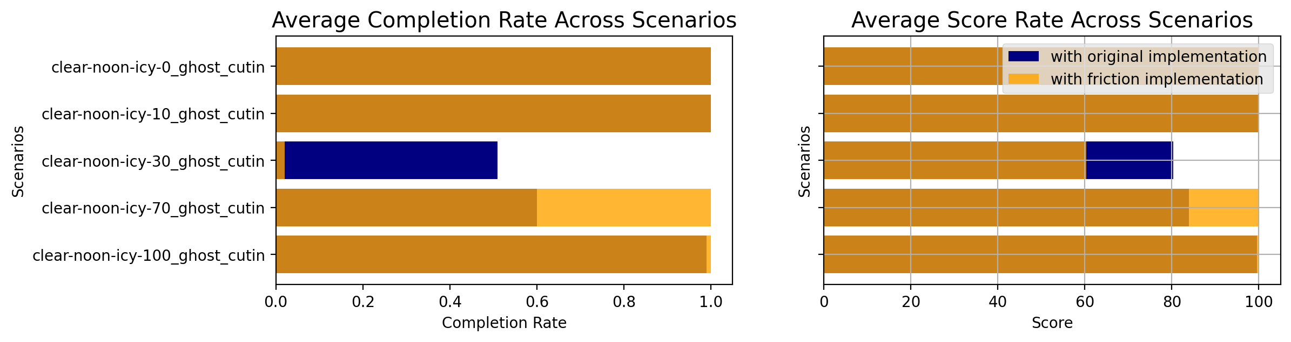
Results
Comparison with Reduced Friction in Front Accident Scenario
Comparison with Reduced Friction in Ghost Cut-in Scenario
ELECTRICAL & COMPUTER ENGINEERING
GRAINGER ENGINEERING
Notes:
Here are the average completion rate and average score across rainy and icy scenarios for front accident and ghost cutin, respectively. You can see that the reduced friction did have an impact on these two metrics, especially when the intensity is not too high. This suggests that, with low intensity in weather parameters, there are not enough visual ques for the AV to drive cautiously, leading to an accident.
It successfully showed the implementation worked.

Slide 16
Future
Conclusion
Reducing the friction of tires affects the behavior of the AV
Proving that current simulation is not sufficient
Trends
Delayed motion
Effortful control signals
Possible to cause accident when tuned to the extreme.
Rain vs ice
Leading to accidents and further loss of control
Future Work
Improving camera input
ELECTRICAL & COMPUTER ENGINEERING
GRAINGER ENGINEERING
Notes:
In conclusion, reducing the friction of tires, according to a mathematical model, affects the behavior of the AV, proving that current simulation is not sufficient.
With reduced friction, not only is the vehicle’s motion more delayed as friction decreases, but it can require the AV to issue more effortful control signals to the vehicle and lead to a potential accident.
In rainy weather parameters, the frictions are not reduced as much. While the trends still apply, the effect was not as dramatic and produced few accidents.
Besides the deviation from the original metrics, it can significantly affect the vehicle’s behavior, resulting in accidents that would not happen with original friction. In the more extreme case, it can cause vehicles to lose control, posing a greater threat to all possible participating vehicles on the road. However, that is not always reflected in an increase in the accident rate, but such deviation can be seen from a detailed DTW plot included in the thesis.
In the future, I would like to modify the camera input according to the weather to further make the simulation closer to the real world.

Slide 17
Questions?
Details on implementation and results:
https://github.com/JackZihengChen/CARLA-Modified-Pipeline (forked from [5])
ELECTRICAL & COMPUTER ENGINEERING
GRAINGER ENGINEERING
Notes:
For more video recordings of scenarios and in depth evaluation, please checkout my github listed here.
https://github.com/JackZihengChen/CARLA-Modified-Pipeline
Thank you!

Slide 18
References
References
[1] https://www.cnn.com/2023/01/17/business/tesla-8-car-crash-autopilot/index.html
[2] https://www.nytimes.com/2022/06/15/business/self-driving-car-nhtsa-crash-data.html
[3] https://carla.readthedocs.io/en/latest/core_world/#weather
[4] Hippi, Marjo & Juga, Ilkka & Nurmi, Pertti. (2010). A statistical forecast model for road surface friction.
[5] https://github.com/bradyz/2020_CARLA_challenge
ELECTRICAL & COMPUTER ENGINEERING
GRAINGER ENGINEERING

